Slide 1
TDD with Python
Chapter 07
CIDM6330

Slide 2
TDD Flow: Incrementalism
We want to stick to small design in the TDD perspective
Large upfront design is inconsistent
TDD is agile
Remaining features
Storage of individual lists
A list is a multi-attribute entity
We want to persist lists on a per-user basis
Another TDD-ism: YAGNI
You Ain’t Gonna Need It

Slide 3
Progression to REST
Representational State Transfer is a system of appropriating HTTP Request Methods to approximate application state for CRUD operations
We being to define routes that represent these operations

Slide 4
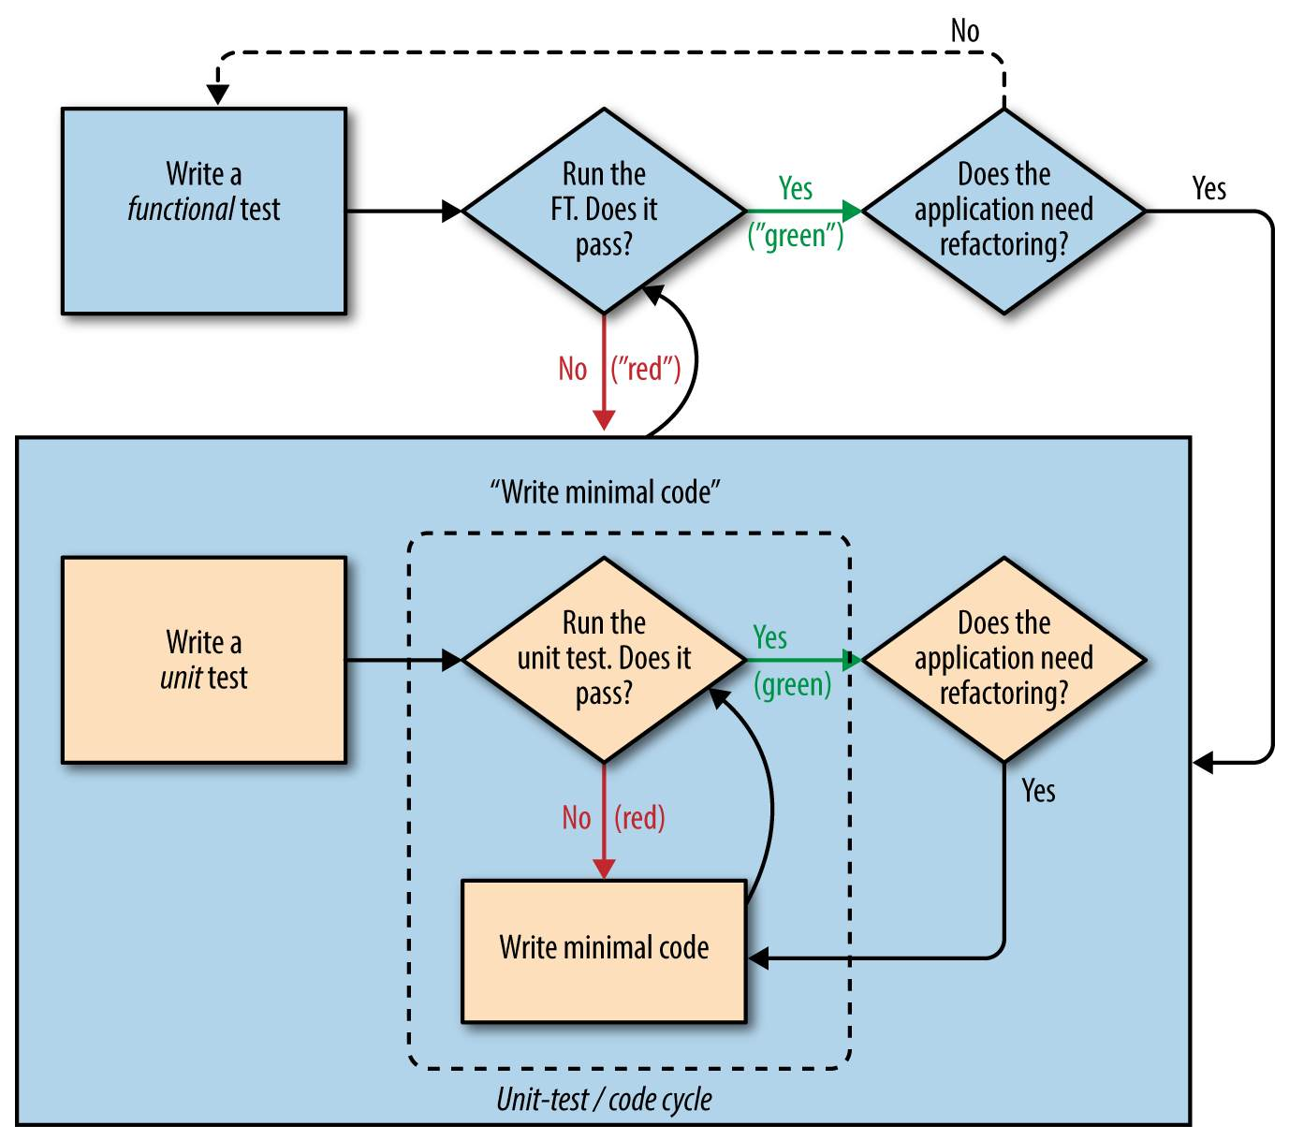
TDD Design Pattern

Slide 5
Regression Testing
Ensuring that new features and design do not break extant features and designs
Unintended consequences
It is regression testing because you are seeking to detect and forestall regression
Two steps forward, one step back

Slide 6
Last TDD Thoughts
As with Agile, TDD focuses on maintaining working code
We move from working state to working state
Keep it small and manageable
YAGNI
Red, Green, Refactor
Also, DRY

